Slide 1
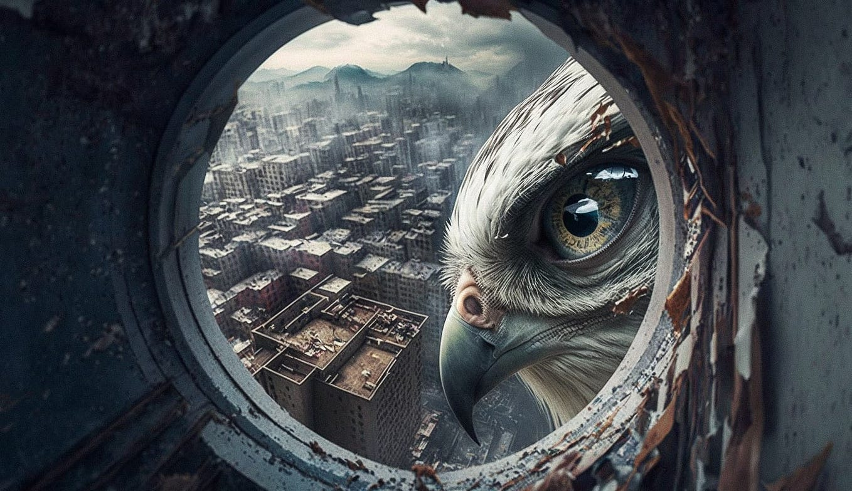

Slide 2
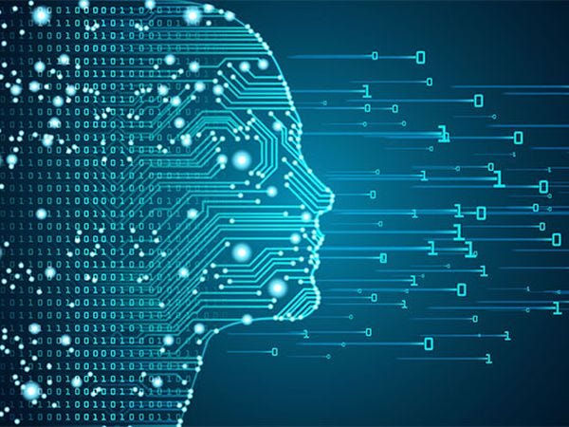
THE UNDERSTANDING OF CNN & CLASSIFICATION & OBJECT DETECTION

Slide 3
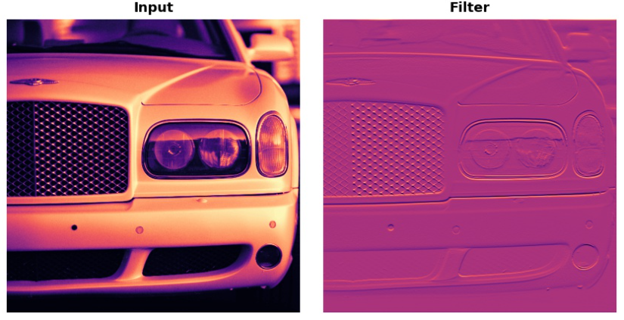
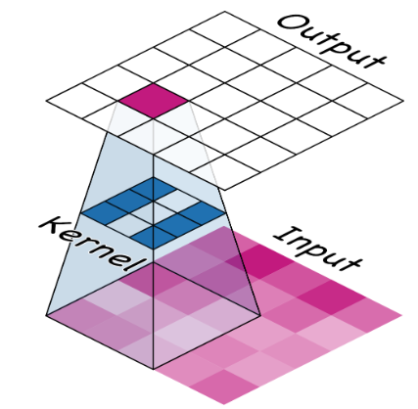
(A) Convolutional Neural Network (CNN):
Convolutional Neural Networks are a powerful artificial neural network technique.
Convolution is mathematical operation by which we produce a new function by two functions .
They are popular because people are achieving state-of-the-art results on difficult computer vision and natural language processing tasks.
Convolutional layers are comprised of filters(Kernel) and feature maps(Activation).
(1) Filters(Kernels):
Filter an image for a particular feature (convolution). These filters are small matrices that slide across the input,
performing element-wise multiplication and summation (convolution).

Slide 4
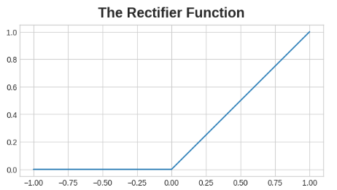
(2) Feature Map(Activation):
Detect that feature within the filtered image.
Example : Feature detection with ReLU.
ReLU(Rectifier Linear Unit):
After filtering, the feature maps pass through the activation function. The rectifier function has a graph like this:
A neuron with a rectifier attached is called a rectified linear unit. For that reason, we might also call the rectifier function the ReLU activation or even the ReLU function. The ReLU activation says that negative values are not important and so sets them to 0. ("Everything unimportant is equally unimportant.")

Slide 5
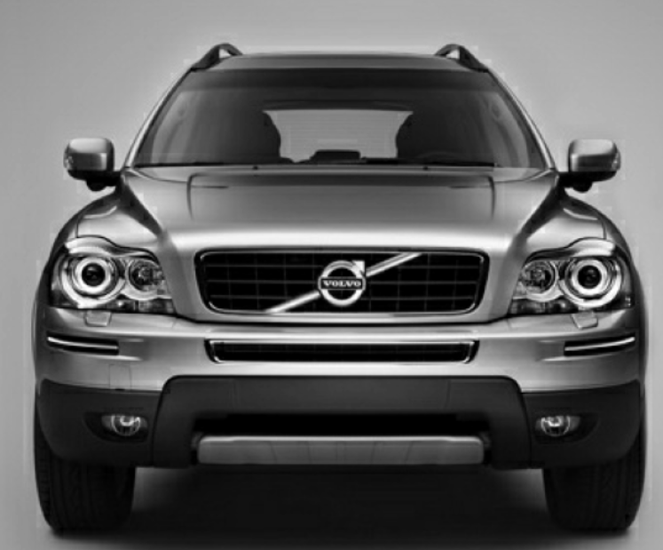
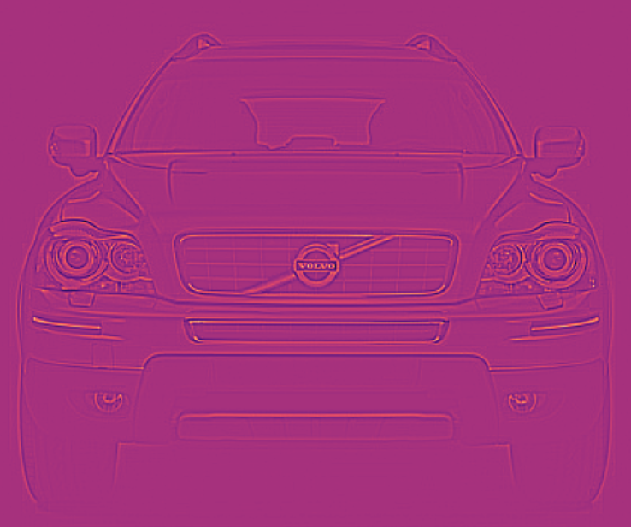
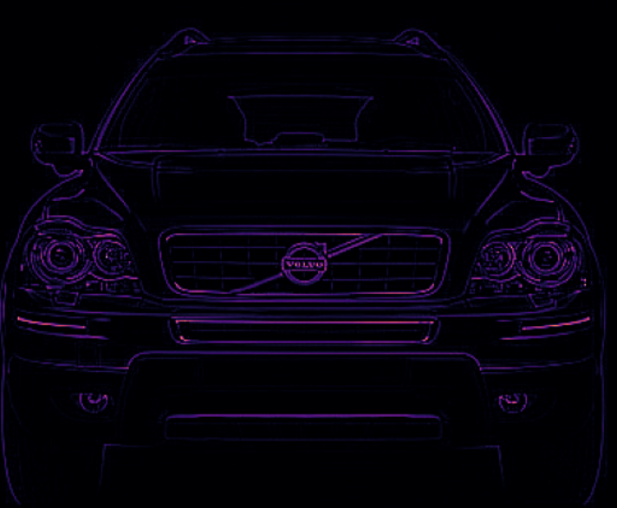
INPUT IMAGE:
FILTERED IMAGE:
Convolution
Activation(ReLU)
IMAGE AFTER FETURE DETECTION

Slide 6
CNN
FULLY CONNECTED LAYERS
POOLING LAYERS
CONVOLUTION LAYERS

Slide 7
(1) Convolution Layers :
It comprised of filters(Kernel) and feature maps(Activation). We have already discussed both of concept .
(2) Pooling layers :
Pooling involves iterating over an input layer and “pooling” the information into a smaller output layer using
some sort of transformation to filter information.
POOLING
MAX POOLING
AVERAGE POOLING
Takes the maximum value across the entire feature map.
Computes the average of all values in the feature map.

Slide 8
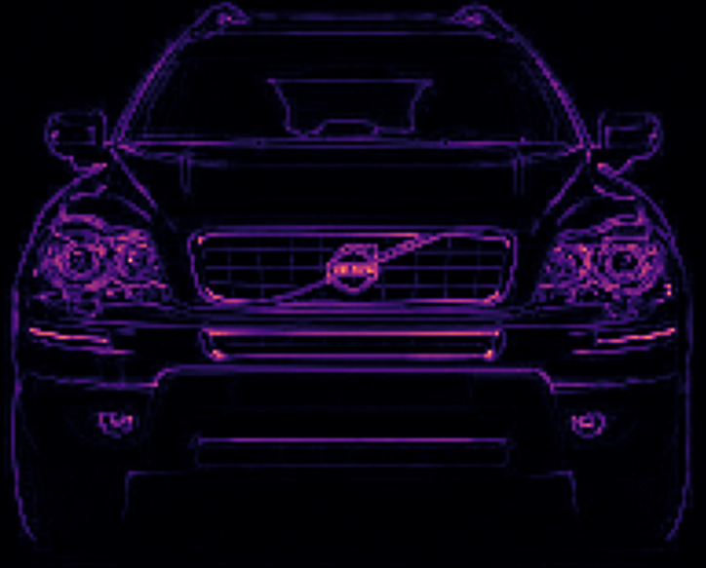
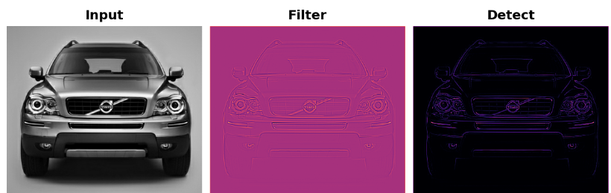
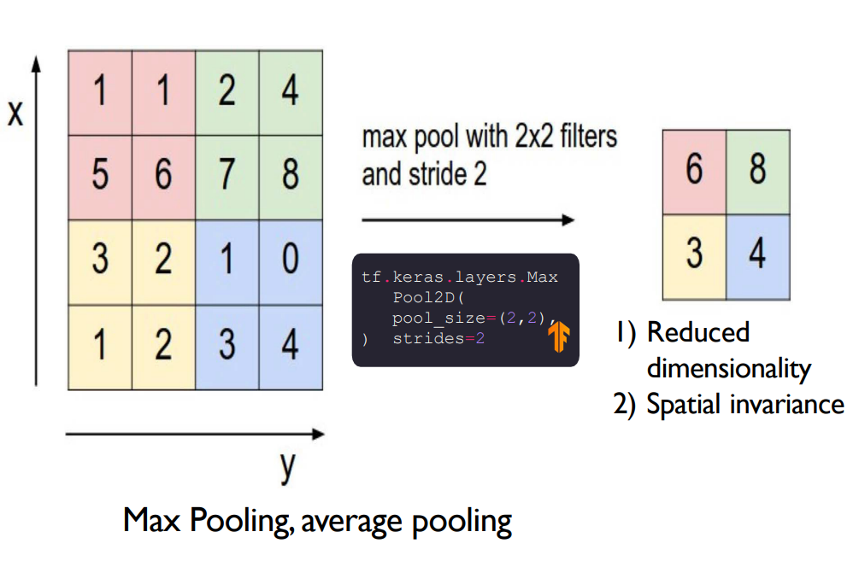
EXAMPLE :
Max Pooling(It is the condense step).
MAX POOLING(2D)
POOLING
How max pooling works:

Slide 9
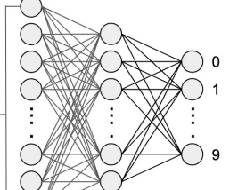
Key Factors to Consider for Optimizing Pooling Layer:
(1)Pooling Window Size: The size of the pooling window affects the degree of down sampling. A larger window
results in more aggressive down sampling but may lose important details.
(2)Stride: The stride determines how much the pooling window moves at each step. A larger stride results in
greater. dimensionality reduction.
(3)Padding: In some cases, padding is used to ensure that the pooling operation covers the entire input feature
map.
(3) Fully Connected Layers:
(1) Fully connected layers are the normal flat feedforward neural network layer.
(2) Fully connected layers are used at the end of the network after feature extraction and consolidation has
been performed by the convolutional and pooling layers.

Slide 10
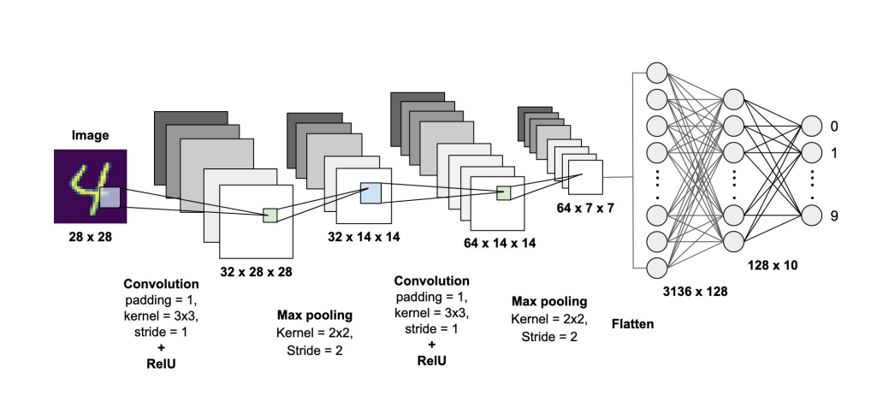
CNN Architecture:

Slide 11
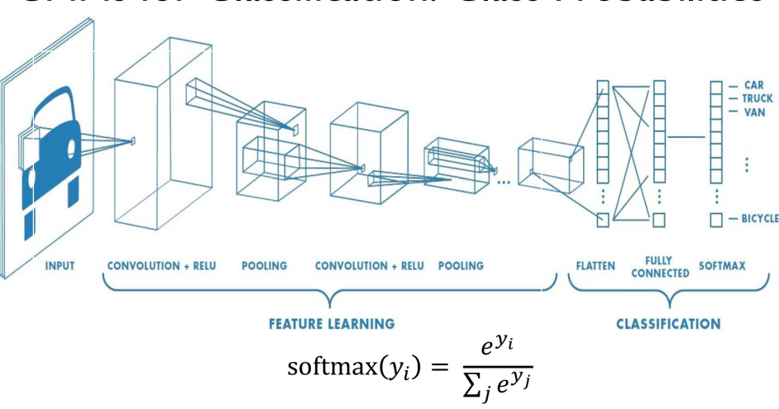
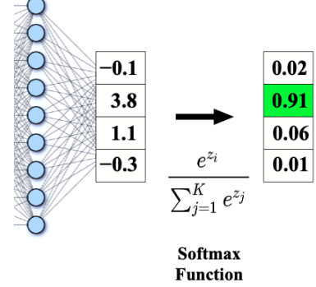
(B) CLASSIFICATION :
CONV and POOL layers output high-level features of input.
Fully connected layer uses these features for classifying input image.
Express output as probability of image belonging to a particular class.

Slide 12
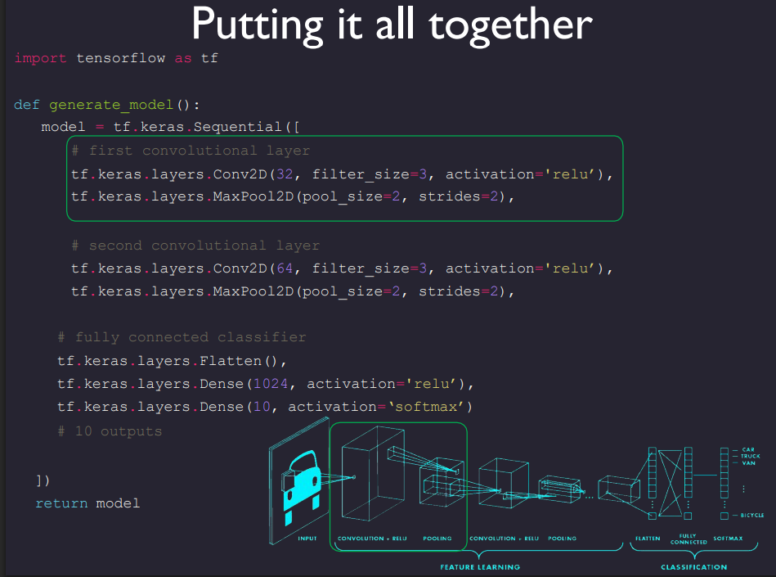

Slide 13
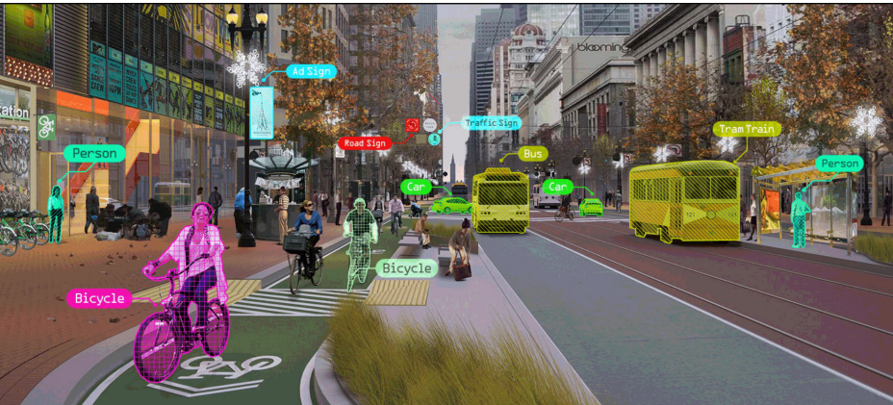
(C) OBJECT DETECTION:
Q. : How can computers recognize objects?

Slide 14
Challenge:
• Objects can be anywhere in the scene, in any orientation, rotation, color hue, etc.
• How can we overcome this challenge?
Answer:
• Learn a ton of features (millions) from the bottom up .
• Learn the convolutional filters, rather than pre-computing them.
OBJECT DETECTION BY YOLO (YOU ONLY LOOK ONCE) :
YOLO model, which is a state-of-the-art CNN based image detection model that ”predicts bounding boxes and class probabilities directly from full images in one evaluation”.
YOLO divides the image into an S × S grid and for each grid cell predicts B bounding boxes, confidence for those boxes, and C class probabilities. These predictions are encoded as an S × S × (B*5 + C) tensor.
There are several model in YOLO , we will discuss YOLOv11 for an example.

Slide 15
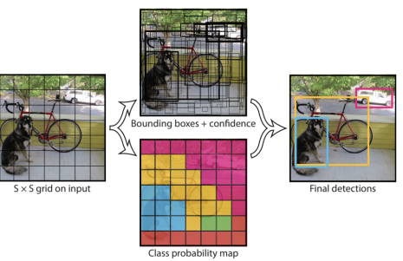
High-level YOLO architecture:

Slide 16
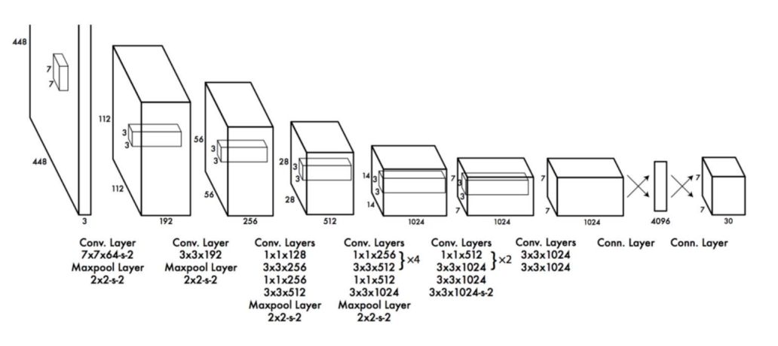
STANDARD YOLO MODEL :

Slide 17
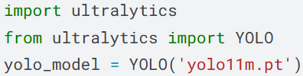
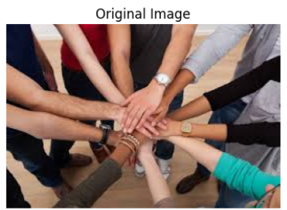
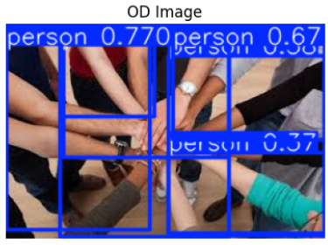
EXAPMLE :
OBJECT DETECTION BY YOLOv11
YOLOv11
Object detection

Slide 18
SOURCE :
https://www.geeksforgeeks.org/deep-learning/cnn-introduction-to-pooling-layer/
https://www.kaggle.com/learn/computer-vision
http://cs230.stanford.edu/projects_winter_2019/reports/15812659.pdf
https://docs.ultralytics.com/tasks/detect/#predict
https://www.kaggle.com/datasets/rehabalsayed/object-detection-for-different-images/code
THANK YOU
SATYAM KUMAR DUBEY

